Slide 1
Why do I need to know about ‘sexting’ and image sharing?
STARTER:
Ella is 14. She’s been going out with Alex for two weeks. He’s 15. Alex pays Ella lots of attention, is kind to her and bought Ella her favourite chocolates yesterday. Alex has just sent Ella a picture of himself, posing, with his shirt off. He’s sent a cheeky text with it:
‘Feel free to return the favour, babe.’
Challenge: What does Alex mean by ‘return the favour’?
Is this a good idea?
More Challenging: Let’s say Ella does return the favour and the couple split up. Describe what the consequences could be.
Mega Challenging: Explain one long term and one short term impact of putting your personal pictures and information in someone else's hands.

Slide 2
Learning Outcomes:
Identify the dangers of sexting and image sharing and whether the case studies are committing criminal offenses or not.
Describe the consequences of sexting, image sharing and the legal consequences for those breaking the law.
Explain both long and short term consequences of sexting and image sharing and analyse why the age of consent for sex differs from consent to sexting.
Keyword: sending, receiving, or forwarding sexually explicit messages, photographs or images, usually between mobile phones but could be any digital device.

Slide 3
Watch the clip and answer the questions below at your challenge level. The clip is quite fast paced so we’ll watch it twice.
What was the biggest mistake of Ally’s life?
What bargain did Ally’s ex-boyfriend try and make with her?
What happened to Ally at the cheerleading competition?
How long do many teenagers unrealistically think they will be with their boyfriend or girlfriend for?
What isn’t sexting?
What is sexting?
Why did Ally’s boyfriend asking her for the picture make her feel better in the short term?
What percentage of recipients forward the image on? (This doesn’t even include just showing people on the phone!)
https://www.youtube.com/watch?v=nsfcN2Hi_ts
Notes:
https://www.youtube.com/watch?v=nsfcN2Hi_ts (creative commons license)
https://www.flickr.com/photos/pro-juventute/10817152306 (labelled for reuse)

Slide 4
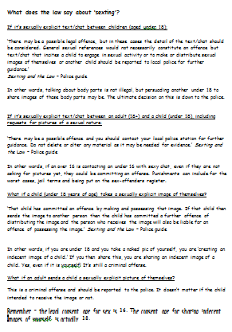
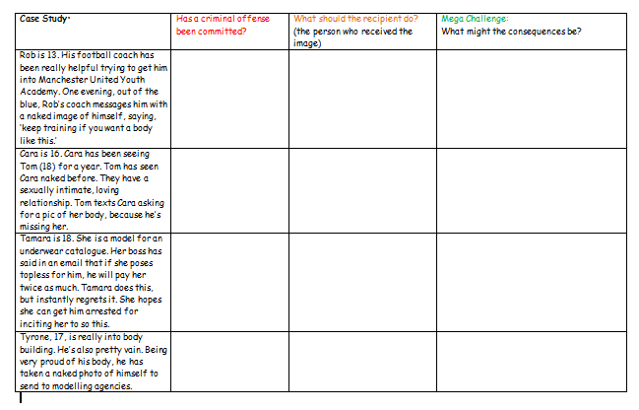
READING ALOUD OPPORTUNITY:
We will now read the ‘Sexting and the Law’ information sheet together as a class.
DISCUSSION POINT 1
Is there anything that surprises you about this information? Why?
DISCUSSION POINT 2
‘Remember – the legal consent age for sex is 16. The consent age for sharing indecent images of yourself is actually 18.’
Why do you think this is the case? Discuss for two minutes then explain in your books. Be ready to feed back.

Slide 5
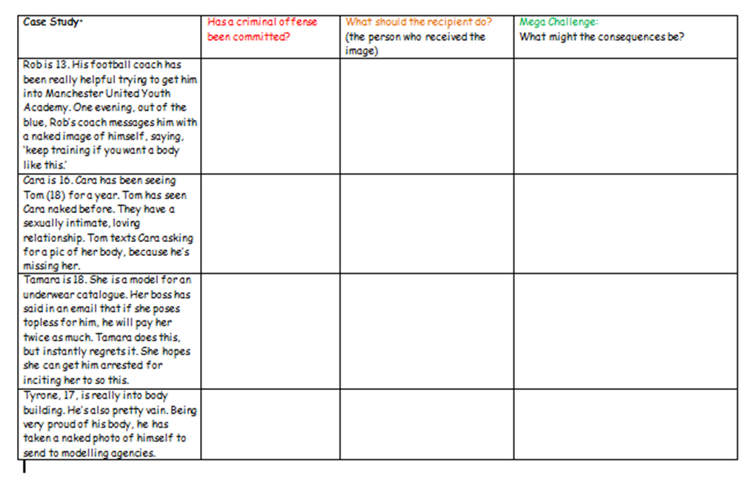
We’re now going to examine some case studies.
Read the case studies in your pairs and use your ‘sexting and the law’ information sheet to help you complete your table at your challenge level.
Be prepared to feed back your answers to the class.

Slide 6
Mini-Plenary:
Your friend has missed today’s lesson.
Create a SnapChat or tweet summarising the three most important things you’ve learned about sexting and image sharing.
More challenging:
You can only use 30 words!
Learning Outcomes:
Identify the dangers of sexting and image sharing and whether the case studies are committing criminal offenses or not.
Describe the consequences of sexting, image sharing and the legal consequences for those breaking the law.
Explain both long and short term consequences of sexting and image sharing and analyse why the age of consent for sex differs from consent to sexting.

Slide 7
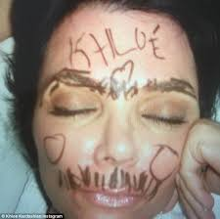
What is consent and why is it so important we learn about it?
Hannah went to a friend’s sleep-over. After staying up late and having fun, she fell asleep first. As Hannah slept, her friends decided to draw on her face with marker pens.
The next day Hannah was furious. Not only could she not get the pen off but she felt horrible and weird about her friends doing things to her while she was asleep.
Why did this make Hannah feel so horrible?
Would she have felt different if she couldn’t get the pen off but had allowed them to draw on her?
Explain the meaning of the word ‘consent’.

Slide 8
What is consent and why is it so important we learn about it?
Key Terms
Consent – to give permission for something to happen.
Non-consensual – doing something without someone’s permission.
Non-consensual sex – this means rape.
Key Words
Learning Outcomes:
Correctly identify cases where consent has or has not been given.
Describe the ‘cup of tea’ analogy and how it can be used to explain consent accurately.
Explain whether consent has been given in particular situations and how you know this.

Slide 9
https://www.youtube.com/watch?v=u7Nii5w2FaI
Watch the clip carefully and then complete the table:
What is the clip trying to say?
Is this point easy to understand?
Are there ever any cases where you should make an unconscious person drink tea, or a conscious person drink it against their will? What could potentially happen if you did?
We’re now going to look at some serious real life instances where people need to be very aware of the concept of consent.
Times people will drink tea. | Times people won’t drink tea.

Slide 10
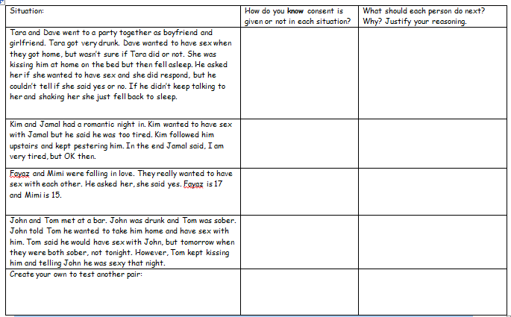
Your teacher will now give you a real life
situations sheet according to your challenge level.
Discuss the situations carefully with your partner and be prepared to feedback to the class with your ideas.

Slide 11
Study the rape-culture pyramid you have been given. When we talk about consent, we might think we’re just talking about ‘to have sex.’
However, there are a lot of serious offenses that can take place without a person’s consent – not just physical sexual acts.
Challenge: 1. What do people mean when they talk about a ‘rape culture’? 2. Why does the pyramid have more things at the bottom than at the top? What is it showing?
More challenging: Why do you think some of these acts have been ‘normalised’?
Mega challenging: Explain three things that must change in society for these acts no longer to be seen by some as ‘normal’.

Slide 12
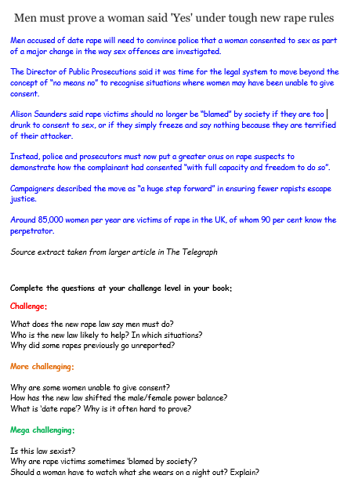
‘Men must prove a woman said 'Yes' under tough new rape rules’
As we read the article as a class underline any words you’re unsure about so I can explain them.
Then, answer the questions at your challenge level.
Be prepared to discuss your answers with the class.

Slide 13
Plenary – Exactly Ten
Summarise in EXACTLY 10 words what the most important thing is about consent that everyone should know……
Learning Outcomes:
Correctly identify cases where consent has or has not been given.
Describe the ‘cup of tea’ analogy and how it can be used to explain consent accurately.
Explain whether consent has been given in particular situations and how you know this.

