Slide 1
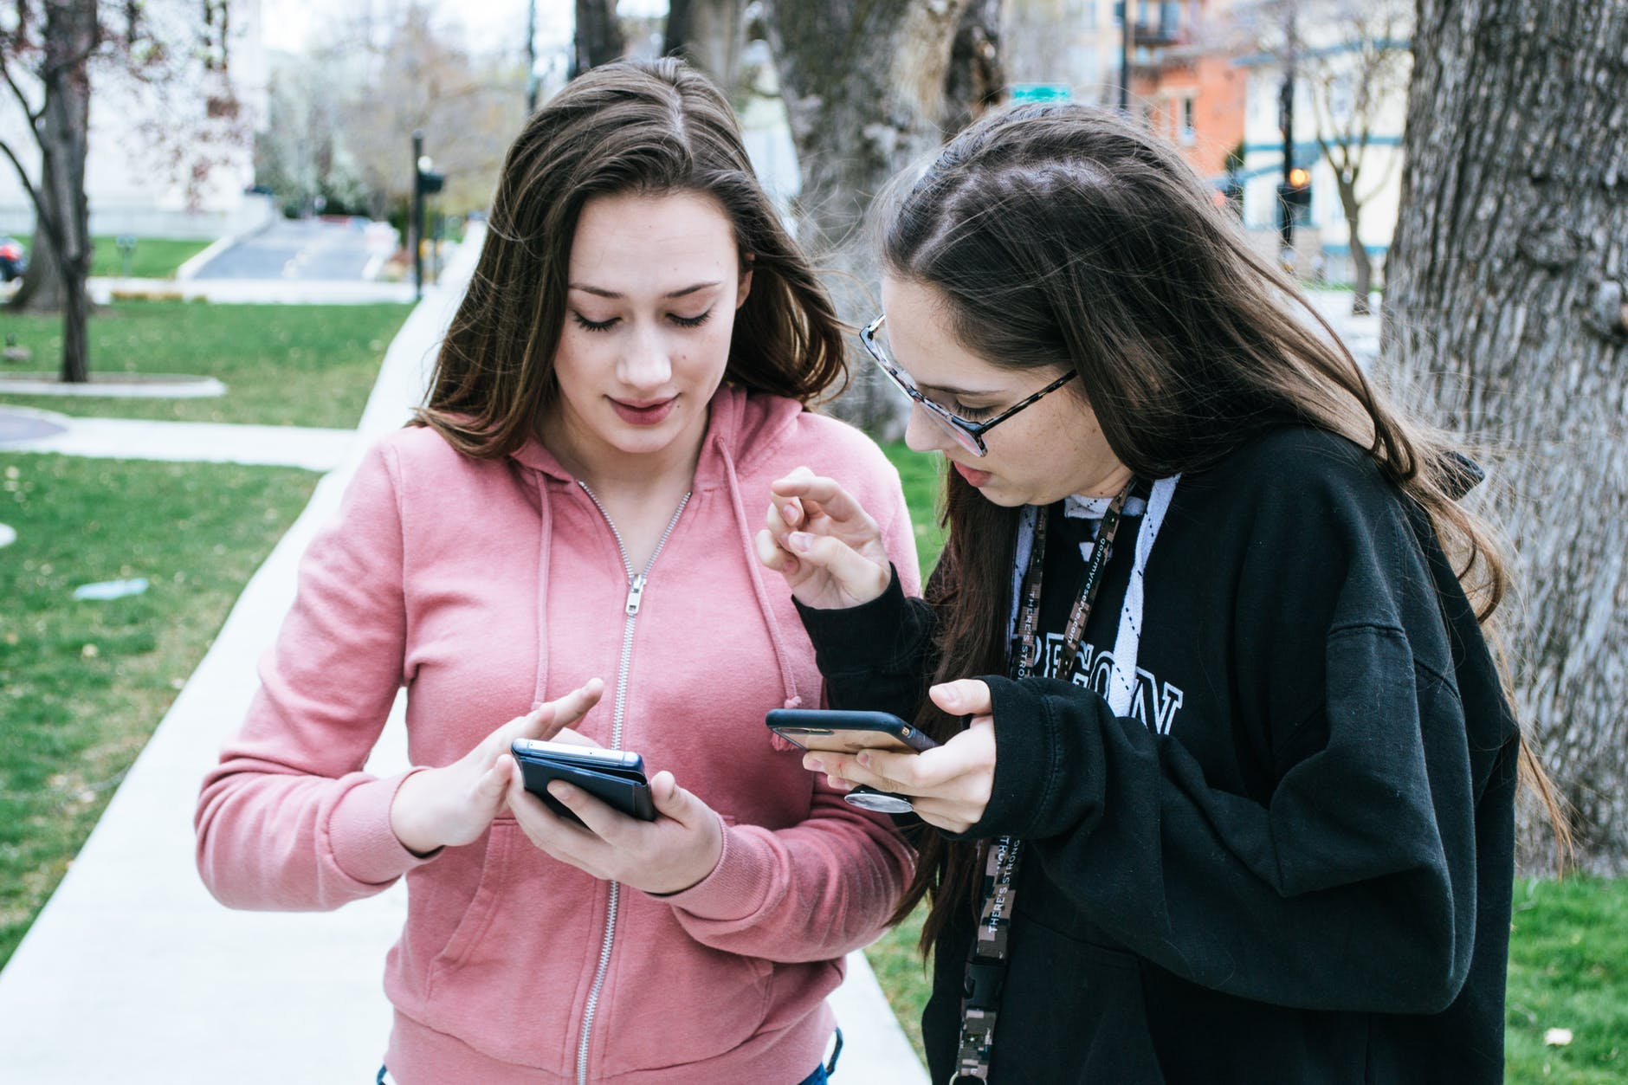
How do we recognise Child Sexual Exploitation and how easily can this happen?
STARTER:
Tim loved my pictures, he says the modelling agency wants to see more!
Eva, you sure this
guy is legit, he’s not some child sexual exploitation creep or something?
Babe, I’m fifteen not eight!
Challenge: Would a real modelling agency ask a 15 year old to send pictures from her phone? What do you think?
More challenging: Why do you think Eva’s friend is worried?
Mega challenge: How could Eva’s friend make sure Eva was safe whilst not putting herself in any danger? Explain.

Slide 2
Key terms:
Child Sexual Exploitation - sexual abuse of under 18s through the exchange of sex or sexual acts for drugs, food, shelter, protection, other basics of life, and/or money. Sexual exploitation includes involving under 18s in creating pornography and sexually explicit websites too.
Learning Outcomes:
Correctly identify the warning signs of CSE and what we can do if we suspect a case of CSE.
Describe three most important red flags for both online and offline safety which suggest cases of CSE.
Explain the manipulation techniques used by abusers and why we should leave investigation to the authorities.

Slide 3
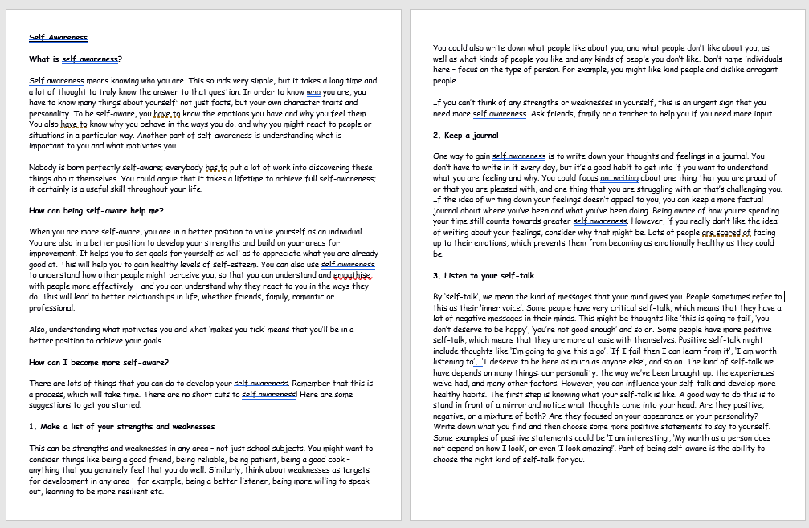
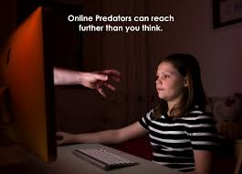
Task One:
We will now find out more
about the warning signs of CSE,
the law and what we can do if
we suspect a case of CSE is
happening.
QUIET READING!
Read the extract that is attached
to this showbie lesson. Make sure
you read carefully as you tutor
might ask you to explain the what
you have read.
You will then complete the
next task.

Slide 4
Task Two: How easily can CSE happen?
Watch and complete your choice of challenges on your worksheet.
https://www.youtube.com/watch?v=pnTYFeZNLkQ
Challenging
1. Name TWO of the things that Dave did in order to make Emma trust him.
2. Name TWO things that Dave did that would count as abuse.
3. How did Emma end up stopping the abuse?
More Challenging
1. What do you think was the first sign that Dave was intending to abuse Emma?
2. How many examples of abusive behaviour can you count in this video? Write a list, explaining how each example counts as abuse.
3. Could Emma’s mum have done more to protect Emma? Explain your answer.
Mega Challenging
1. How is Dave’s attention to Emma different from a normal friendship or young romance?
2. What were the most manipulative techniques used by Dave and why do you think they worked? Explain at least THREE different examples.
3. If you were in Emma’s situation, do you think you would have acted differently? Explain why or why not.

