Slide 1
Task three– reducing instances of CSE
Many initiatives have been set up by governments, charities and Police forces around the world to try to reduce CSE. Some of these have a level of success, however, it is very hard to track every predator as the very nature of their cases involves creating new identities. Therefore a high level of vigilance amongst young people is needed, to ensure you and your friends are safe.
Read the keeping safe guide on the following link:
http://knowaboutcse.co.uk/youngpeople/#keeping-safe
You now have ten minutes to discuss these with your partner
and write down your ideas for your choice of challenge questions
below. Be prepared to feedback to the class.
Challenge:
What do you think the three most important points are for
1) staying safe out and about and 2) staying safe online.
More challenging:
After picking your three most important points for each side, explain why you think these are the most important.
Mega challenging:
Analyse – is there anything either of these checklists are missing? Explain what else could be included and why you think this would be a good idea.

Slide 2
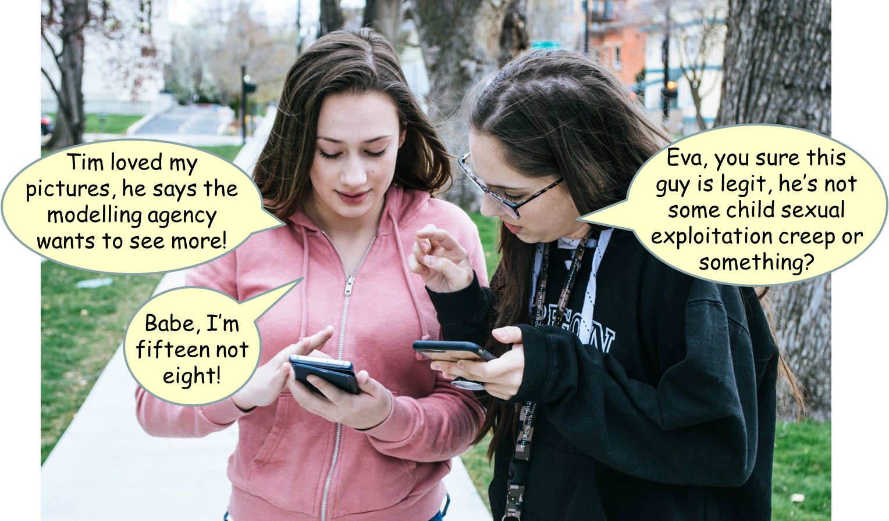
Task 4: Let’s revisit Eva’s situation.
You are Eva’s friend. Eva told you more about Tim. He keeps saying Eva will be visiting the modelling agency, but so far he has just taken her to his house and given her drinks. Eva says she is going to Tim’s tonight to try on a new line of swimwear the agency wants modelling.
Challenge: Note down three more alarm bells (red flag warnings) from Eva’s story. Who needs to be alerted now do you think?
More challenging: What questions should you be asking Eva about her planned visit – should you let her know you are going to tell someone? Explain your ideas.
Mega challenging: ‘It is so important to leave cases like this to the police – you have been an excellent friend by reporting the case.’ Assess the validity of this statement, explaining the dangers you have avoided by following Eva yourself.
All (optional) – Create a page for your school’s newsletter, aimed at making parents aware of CSE, the warning signs and the agencies which provide further help.

Slide 3
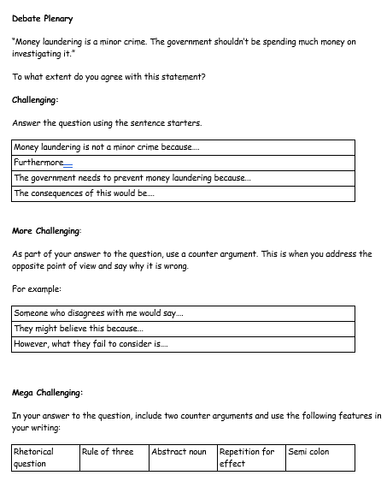
Plenary: Literacy Focus:
Complete your literacy focus task at your challenge level.
Be prepared to feedback and justify your ideas to the class.
‘It is everybody’s responsibility to report possible cases of CSE’

